Slide 1

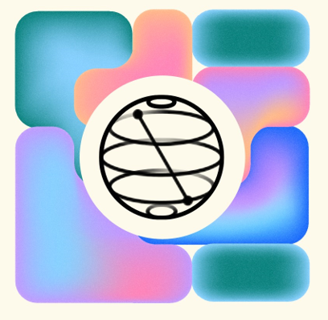
Taylors Qiskit fall fest
Room: ***
Time: ***pm - ***pm
schedule:
***pm - ***pm introduction(30min)
***pm - ***pm hand-on exercise (1hr 15min)
***pm - ***pm Quantum Journey Guide(15min)
Notes:
Short Self-introduction

Slide 2
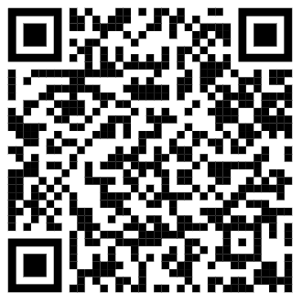
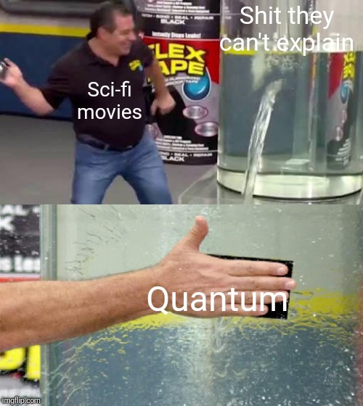
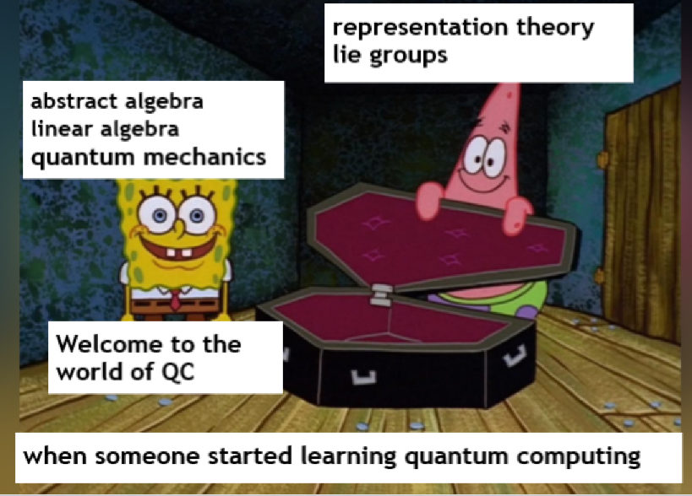
Who am I?
What I wish you could take home today?
Résumé:
Bachelor In Computer science(Sem 2)
one of the 500+ Qiskit Advocate around the world
Quantum Software engineer and part-time researcher
Basic understanding of quantum computing
new friend
how to build quantum circuit and run your first quantum program on real quantum computer on cloud!!!
how to start your own quantum journey
don’t worry, no math is in this workshop

Slide 3
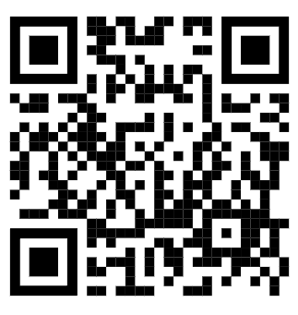
What is Qiskit fall fest
The Qiskit Fall Fest consists of quantum computing events organized by students on college campuses/school around the world, with support from IBM Quantum.
There is more than 60+ community across the world doing the event.
This is the only and the first introduction workshop in malaysia
List of community: (how many recognise name?)
Yale University
UCLA
Cornell University
Korea University
University of Toronto
Stuyvesant High School
and more.. https://qiskit.org/events/fall-fest
Register form for this workshop:

Slide 4
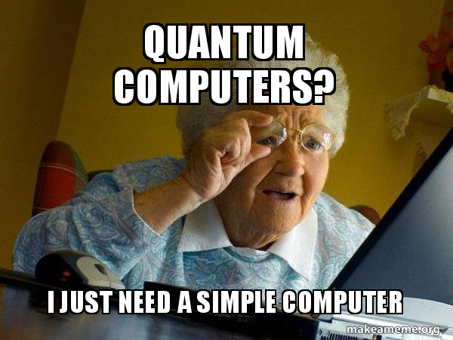
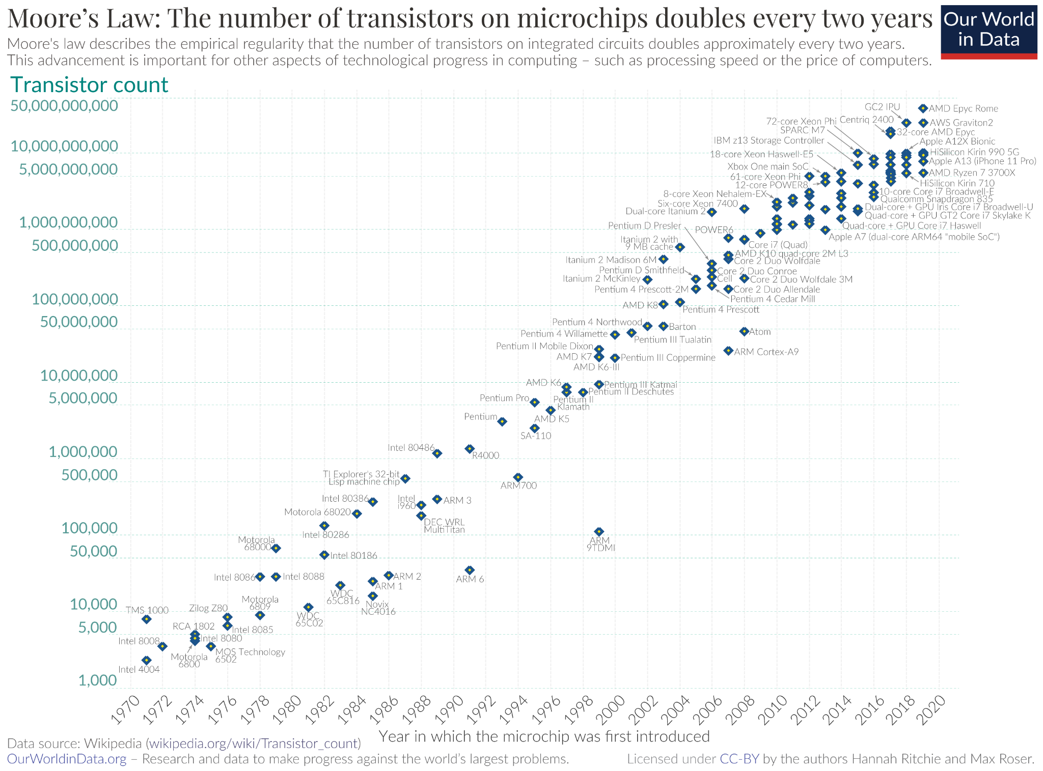
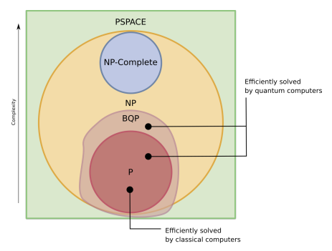
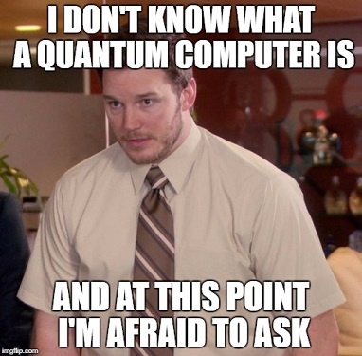
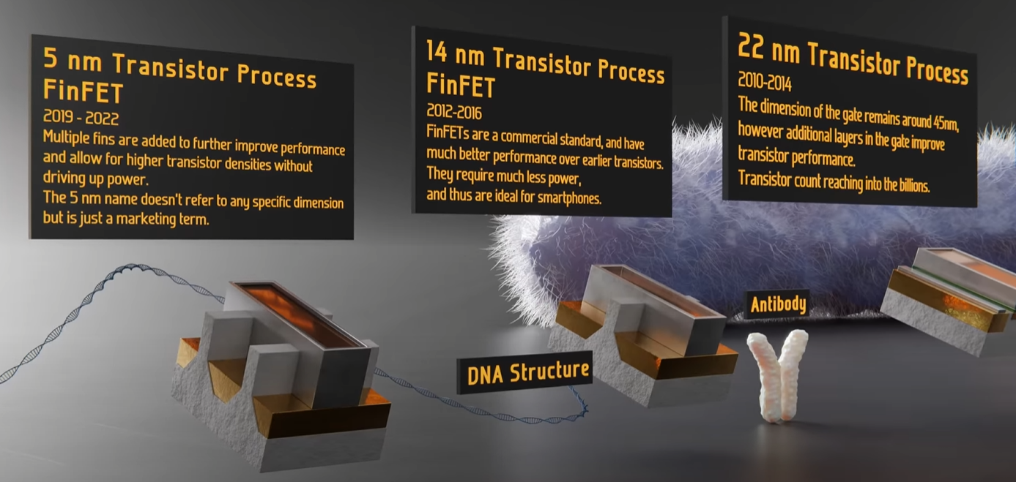
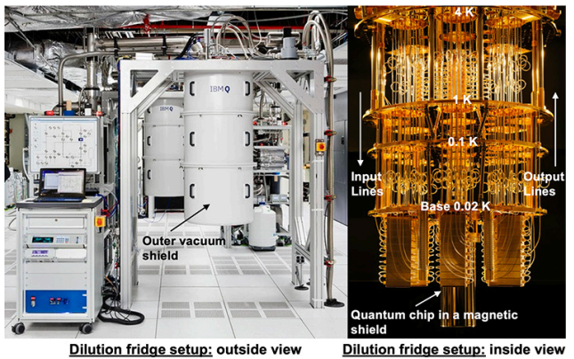
Why Quantum Computing?

Slide 5
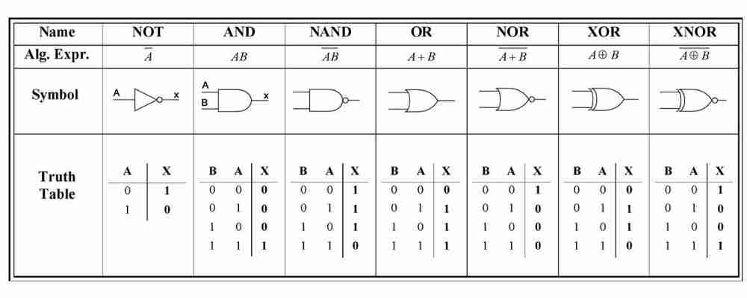
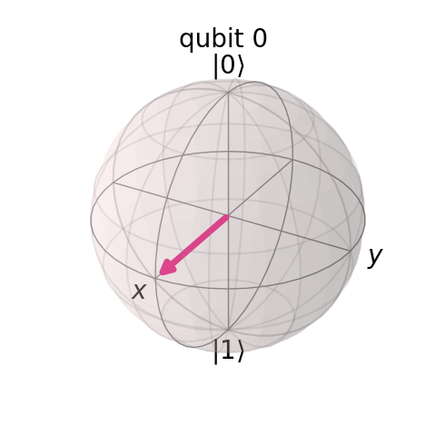
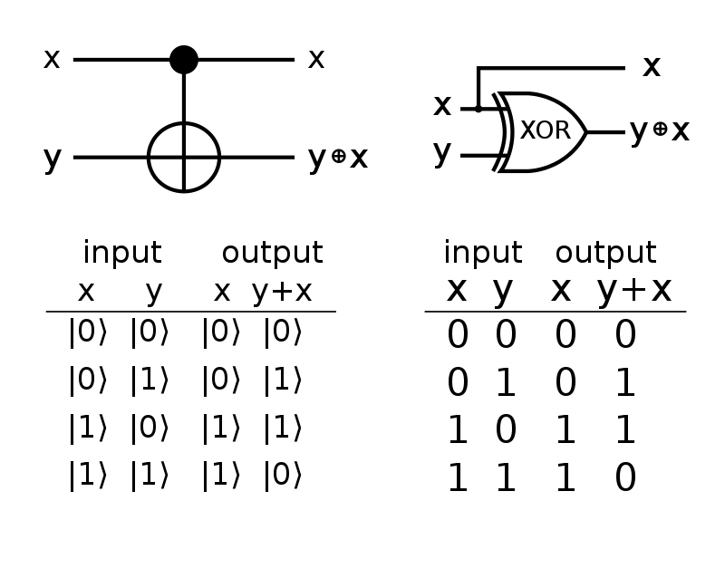

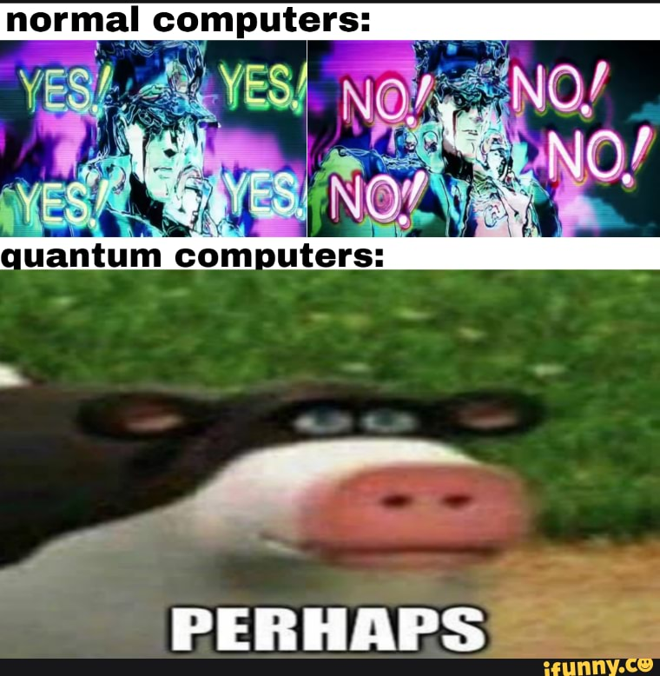
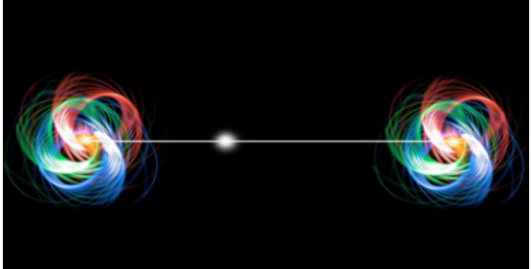
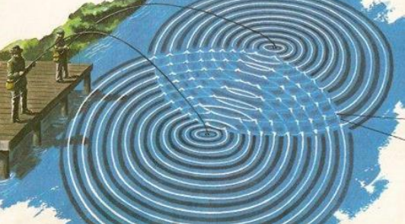
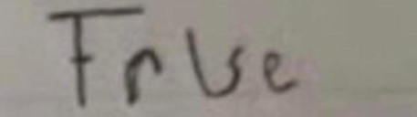
Bits vs Qubits
what is bits?
it can be represent as 0 or 1, its exist in any electronic devices, coined by John Tukey in 1947, and popularized by Claude Shannon information theory paper.
what is qubits?
its can be represent as |0> or |1>, follow the rule of quantum mechanics.
unlike many classical gates, its reversible and nature probabilistic
three things that make it special:
superposition, hold two states at the same time, when we don’t look at it.
entangled, building a special string connection between qubits.
interference, qubit can affect other qubits it entangled to.
Maybe other special properties hence to be discover!!!
blocks sphere
a way to visualize two-level of quantum system
try out: https://javafxpert.github.io/grok-bloch/

Slide 6
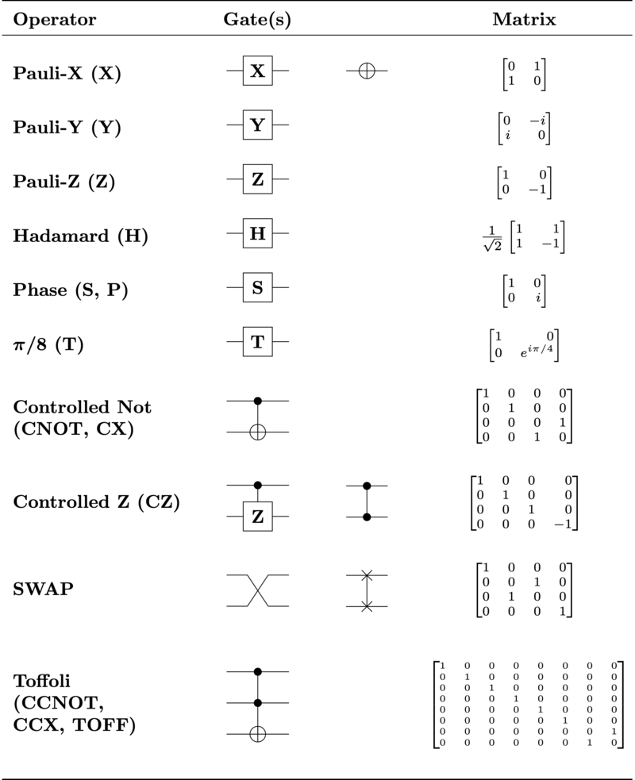
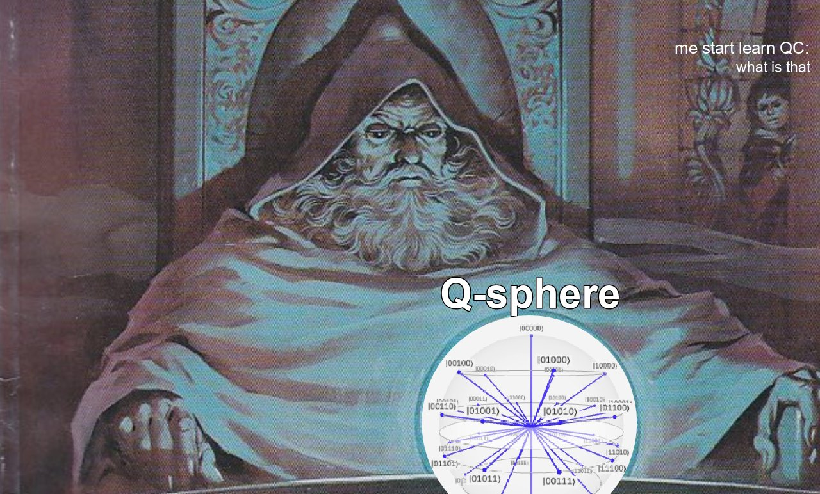
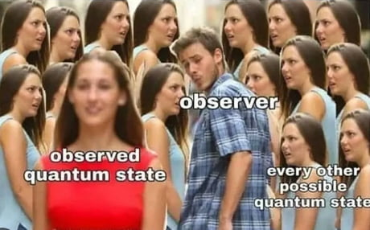
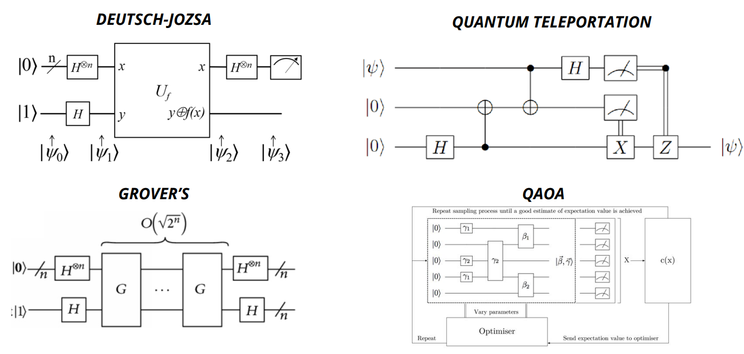
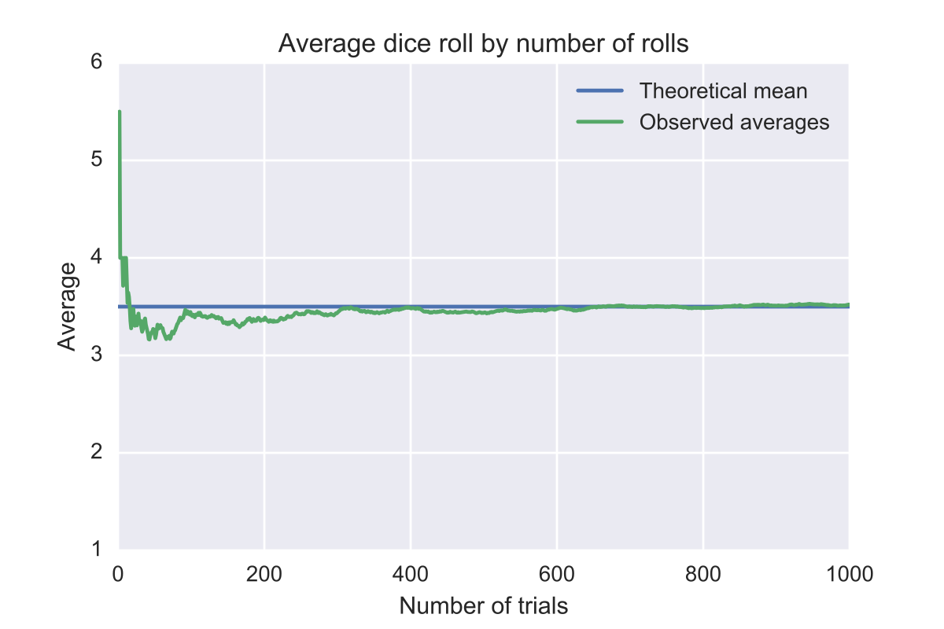
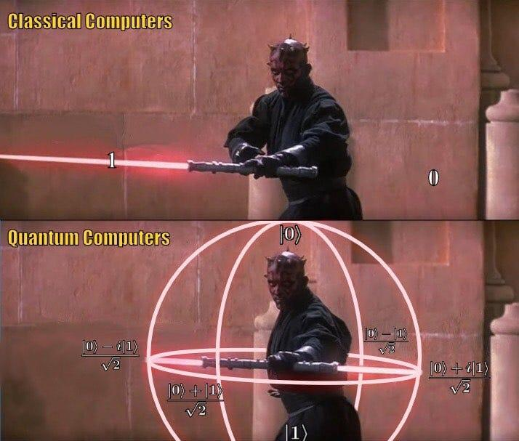
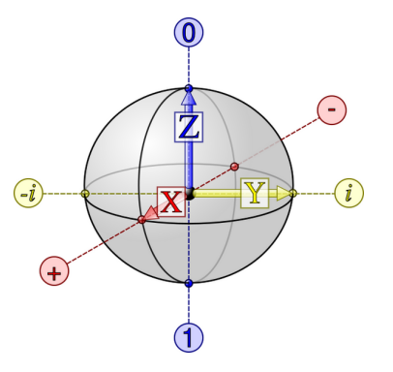
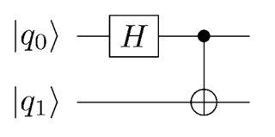
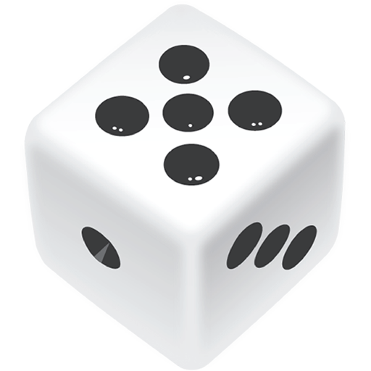
What is Quantum Circuit?
Its a theoretical model for quantum computation, which consist of three key components:
States
Gates
measurement
q-sphere is a way to show all the possibility of multiple qubit
entanglement of two qubit
block sphere
obtain probability from multiple shots

Slide 7
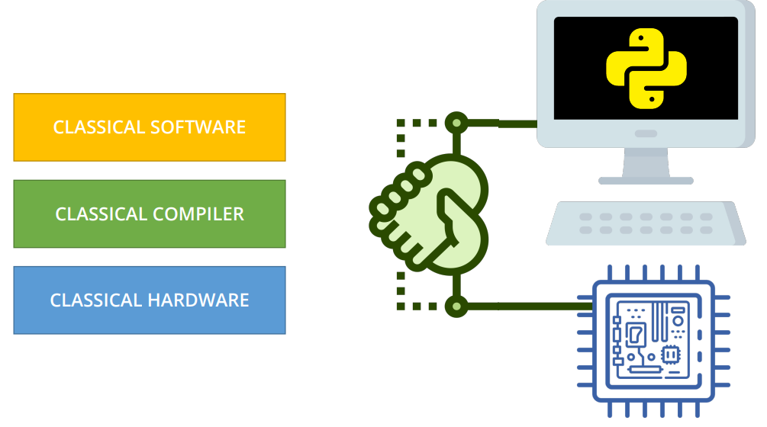
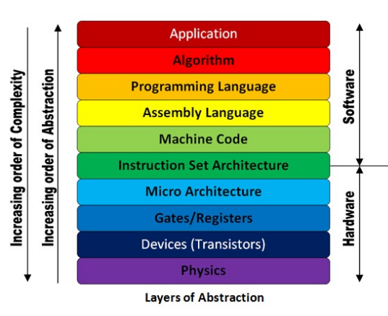
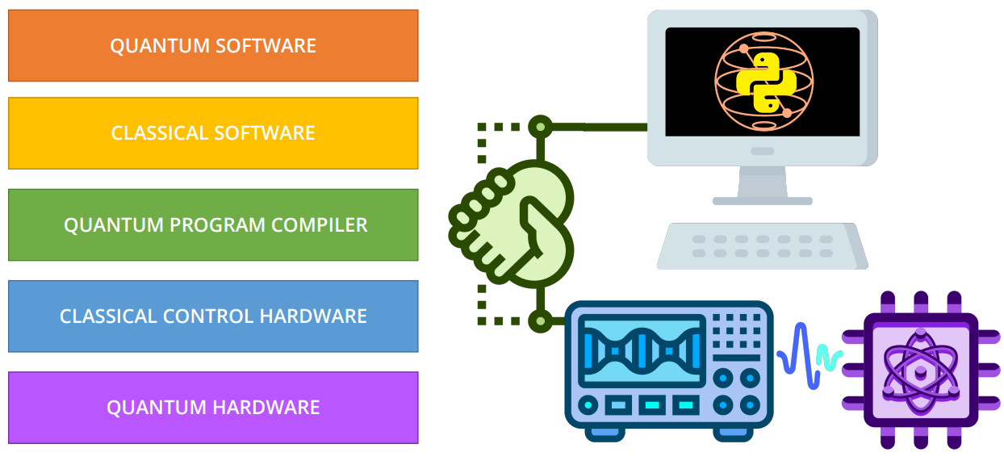
Classical vs Quantum Stack
Full Stack: the entirety of a computer system or application, comprising both the front end and the back end.
Stack show the level of abstraction(programming) to the lowest level of abstraction(transistor)

Slide 8
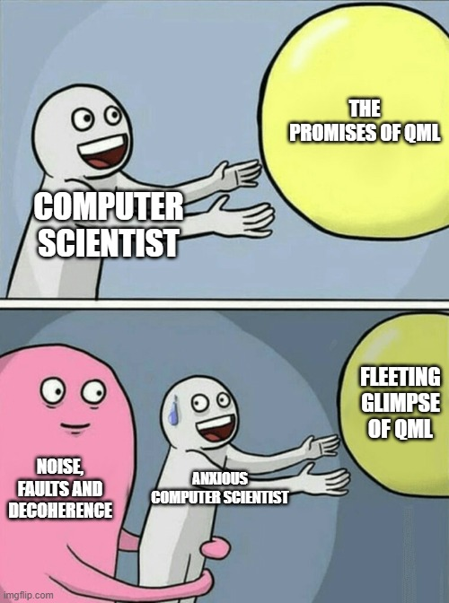
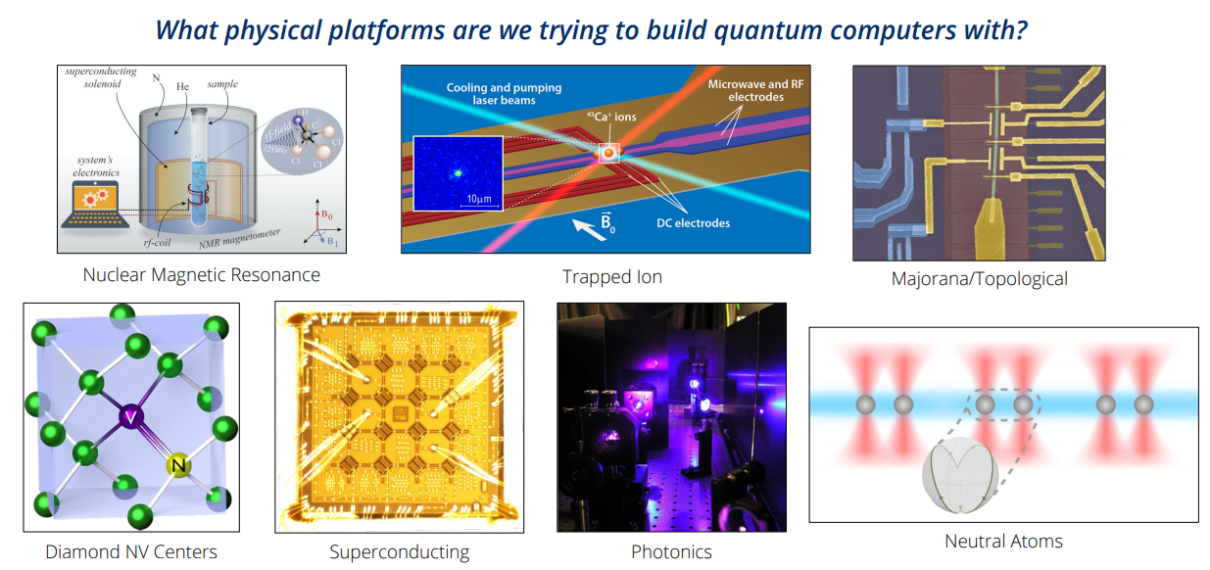
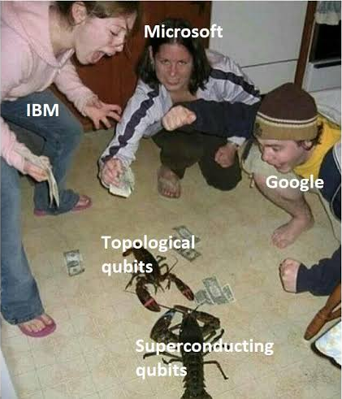

Quantum Hardware
quantum computer can made out of anything, as long as there is quantum mechanics exist
different hardware got its own advantage
Interesting video to learn more:
Can You Make a Quantum Computer out of Olive Oil?
IBM - superconducting
Google & Microsoft - Topology

Slide 9
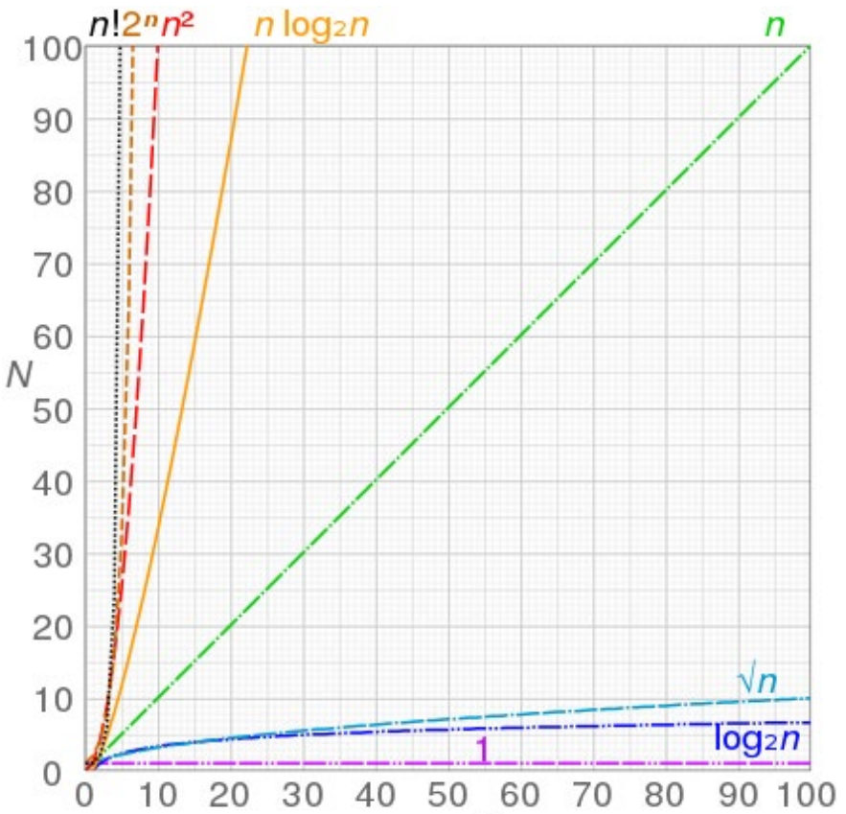
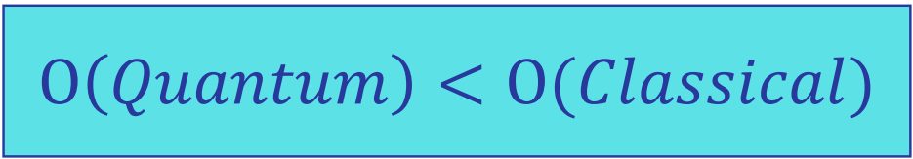
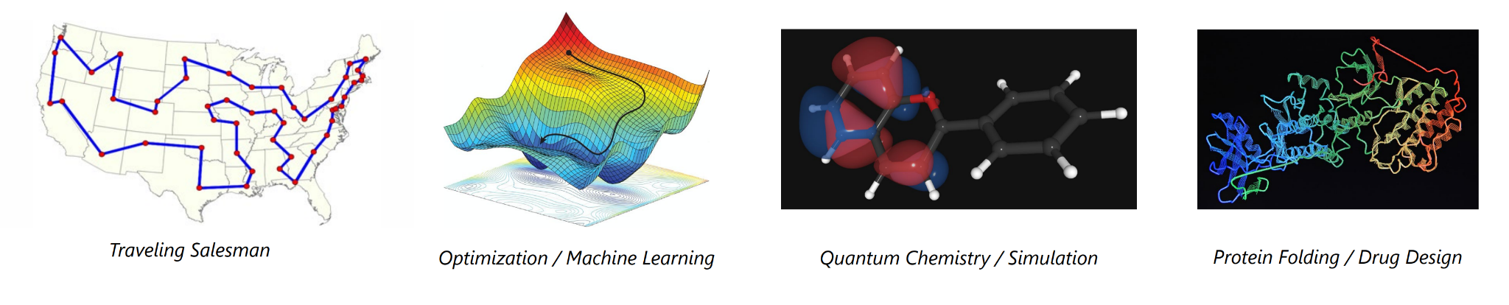
What are the potential application
Big-O show the efficiency of quantum algorithm, the goal is design good quantum algorithm that can beat classical algorithm.

Slide 10
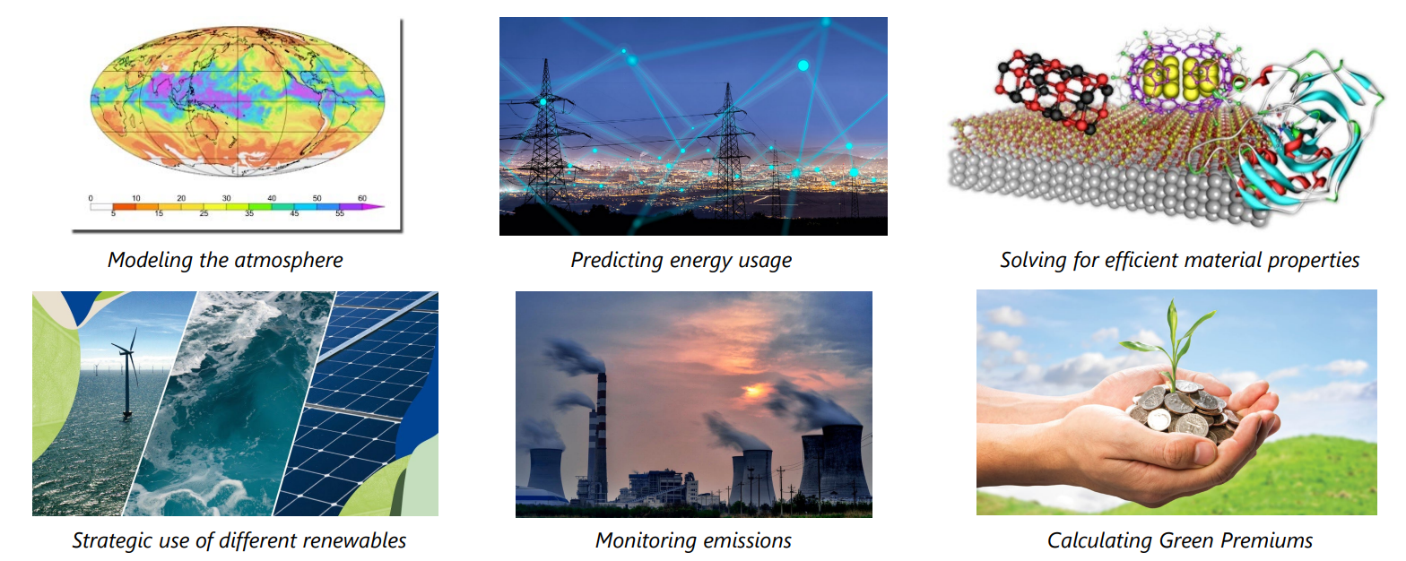
Climate change innovation
policy, economic, insitutionally,technology

Slide 11

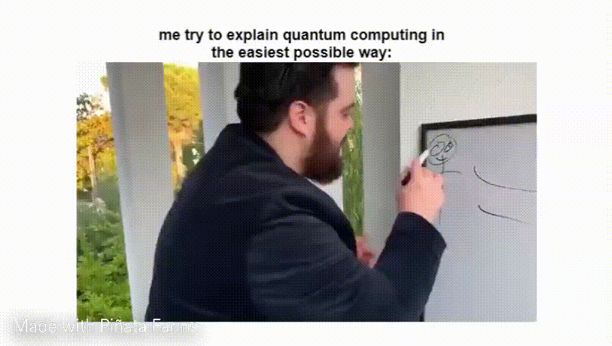

Exercise Section !!!(1hr 15min)
Link:https://github.com/poig/Taylors-University-qiskit-fall-fest
Head over to the github repository,
click the button at the bottom of the page
register for a account and start cracking with the exercise
Please ask any question if you are stuck!!!
First Notebook(10-20min)
Second Notebook(15-30min) - The Quantum Enigmas 001 - The treasure door - YouTube
Third Notebook(30-45min)

Slide 12
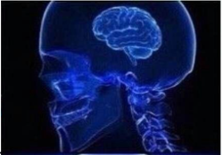
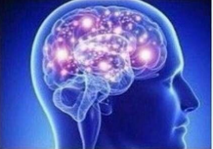
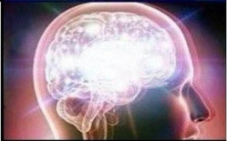
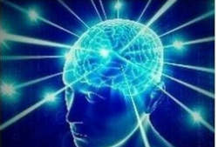
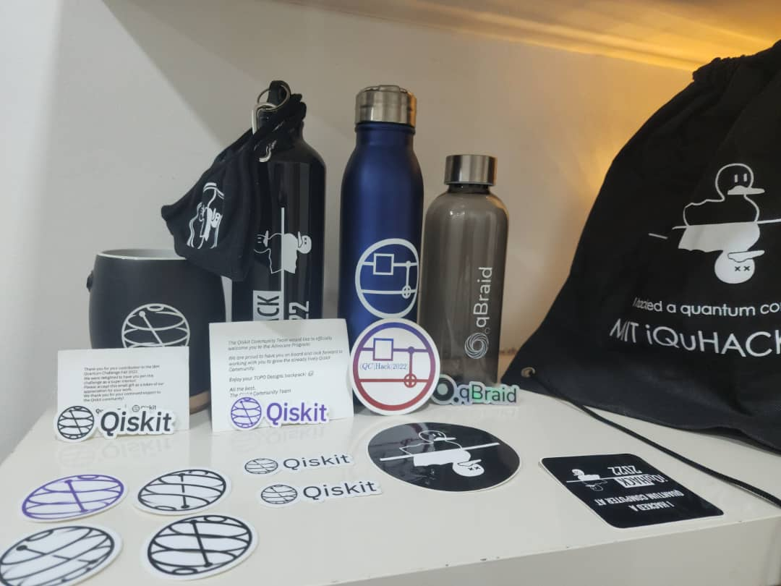
My Quantum journey timeline
01
02
03
04
2020-2021, free online course
Qubit by Qubit:
Introduction to Quantum Computing 8-month course lectured by MIT researcher,
where there is 5000 students around the world take the course online
Best Class ever took in my life
2022
I literally participate all free quantum event online:
iQuHack by MIT
QCHack by Yale & Stanford
etc..
and get some swag (including T-shirt):
2022 Aug, Did some quantum project, contribute to open sources, and got accepted to Qiskit advocate program
worked on QML mentorship project
2022 Nov, Won a hackathon with Quantum Kernel estimation challenge against 630 participants
2023 Jan, Got offer to Quantum software engineer
Publish first research paper 5 months ago:
https://www.mdpi.com/2313-433X/9/7/128

Slide 13
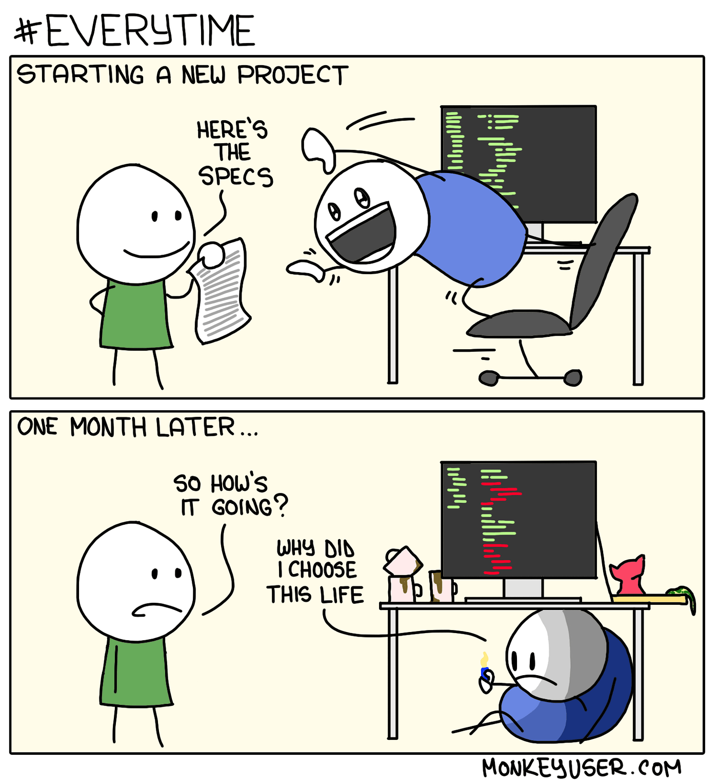
What is qiskit advocate
How to apply?
https://github.com/qiskit-advocate/application-guide
Make Contribution
there is different tier contribution, minimum 20 points to be considered
I did 40-50point by doing two hackathon project using qiskit(10pt), 20 accepted question on stack-exchange(20pt), contribute to open sources(8pt), more..
Pass The Qiskit Developer Certification test
selectively voucher will be given to attend it for free, or you can pay 200 usd.
There is bunch of open resources and guide on qiskit slack channel #qiskit-advocates-application
Submit Application around each mid-year(Jun-July)
will only consider contribution before the deadline.
There is over 500 qiskit advocate around the world, each year 100+ people joining.
with qiskit advocate:
networking with experts and enthusiasts
Getting special access to Qiskit core member and project - mentorship project
get recognized by IBM, higher chances to get hires
Invitation to events, where you will be mentor to teach other and chances of receive special gift from IBM

Slide 14
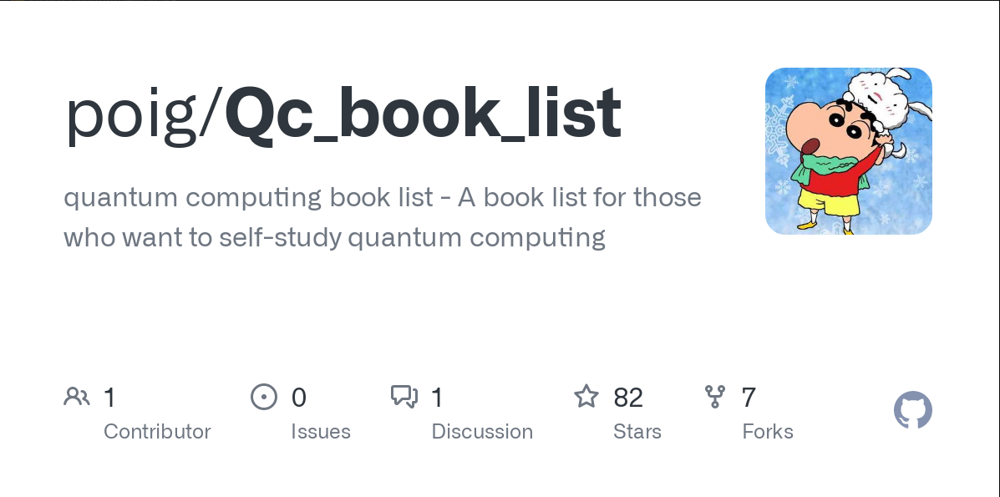
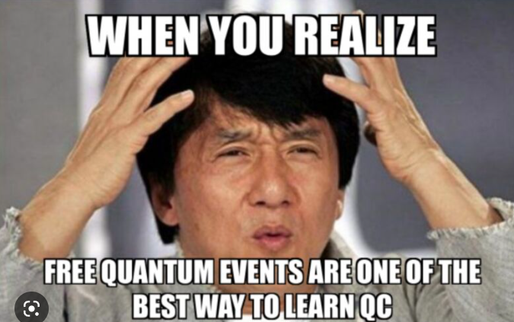
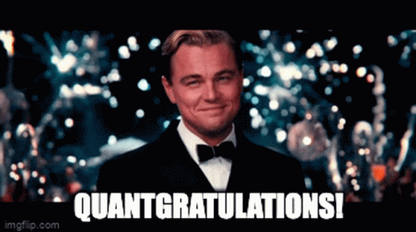
Resources & Tutorial & challenge notebook?
Current on going event, QIST courses by (Malaysia Quantum Information Initiative)MyQI..
Future Quantum event in the future:
IBM coding challenge
Haqs hack (around Jun)
qhack.ai (feburary 08-22)
Stay tune for future quantum event, maybe in UM or Campus
https://github.com/poig/Qc_book_list
youtube video playlist - https://youtube.com/playlist?list=PLGjhJJjulo3T18RkjDBEmg766GLsCV65U&si=tH6zdi_lYNYF9Doo
Thank you so much for attending the workshop!!!
Certification will be sent through email

